Slide 1
Computing Measurement Uncertainty
In Forensic Breath Alcohol Analysis
Rod G. Gullberg MS, PStat
Clearview Statistical Consulting
Seattle, WA

Slide 2
How would you define
“Measurement Uncertainty”
Is it the same as “error”?

Slide 3
Terminology
Uncertainty: the notion of doubt
Error: a mistake (random and systematic)
Uncertainty: The doubt we have about a measurement that is quantified by an interval symmetric about the measurement result within
which we expect to bracket the measurand in repeated measures with a high level of probability

Slide 4
Factors Motivating the Attention on Measurement Uncertainty
NAS Report
“All results for every forensic science method should
indicate the uncertainty in the measurements
that are made,...”.
Daubert vs. Merrill Dow Pharm.
criteria for admissibility “...the technique’s known
or potential rate of error...”.
Accreditation
“…estimating uncertainty of measurement for all reported
‘measurements that matter’” ASCLD/LAB International

Slide 5
For Which Result Has the Concentration
of 0.08 g/210L or More Been
More Confidently Established?
0.086 g/210L
0.104 g/210L

Slide 6
For Which Result Has the Concentration
of 0.08 g/210L or More Been
More Confidently Established?
0.086 ± 0.005 g/210L (±2SD)
0.104 ± 0.027 g/210L (±2SD)

Slide 7

Intervals of Uncertainty (Confidence)
in BrAC Measurement
0.086 ± 0.005 g/210L
0.104 ± 0.027 g/210L
0 0.080 0.200 g/210L

Slide 8
Measurement Uncertainty is Synonymous with Measurement Variability

Slide 9
Measurement Uncertainty
Idaho Case Law:
Court cases from Idaho are unique regarding this issue of measurement uncertainty. [State v. Jones 2016 and Elias-Cruz v. Idaho Department of Transportation 2012] The court ruled that “…a violation can be shown simply by the results of a test for alcohol concentration that complies with the statutory requirements… the margin of error in the testing equipment is irrelevant”.

Slide 10
Measurements possess uncertainty due to:
Limits in analytical technology
Calibration/bias
Electronic components
Software
Random variation
Variation in the sample source
Limits in scale resolution
Procedural variability
Unclear definition of the measurand (breath, blood)
Form of the function relating Z to x,y,w,…
0.094 g/210L ± 0.0042
Uncertain but meaningful digit

Slide 11
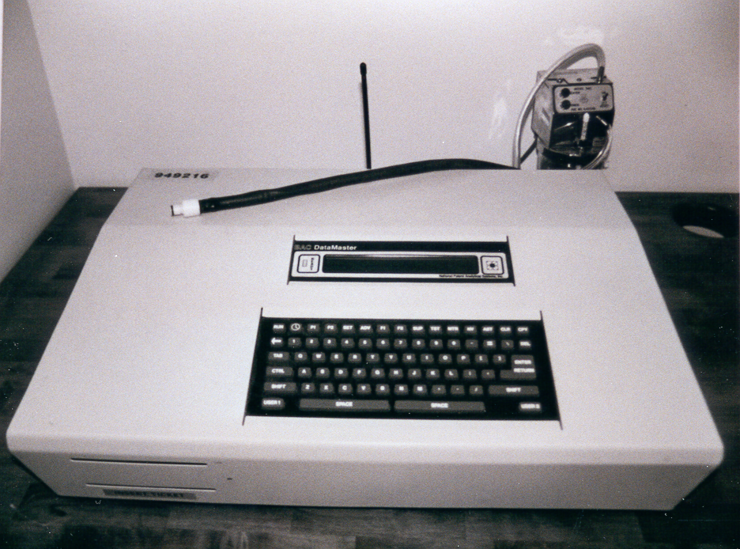

Slide 12
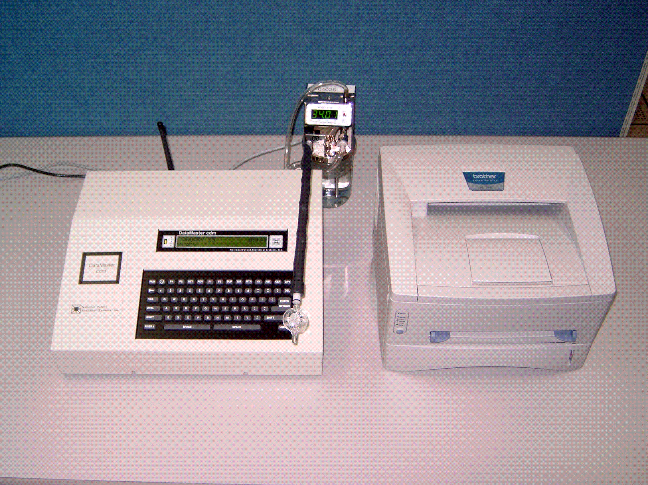
Drager 9510 Breath Alcohol Test Instrument

Slide 13
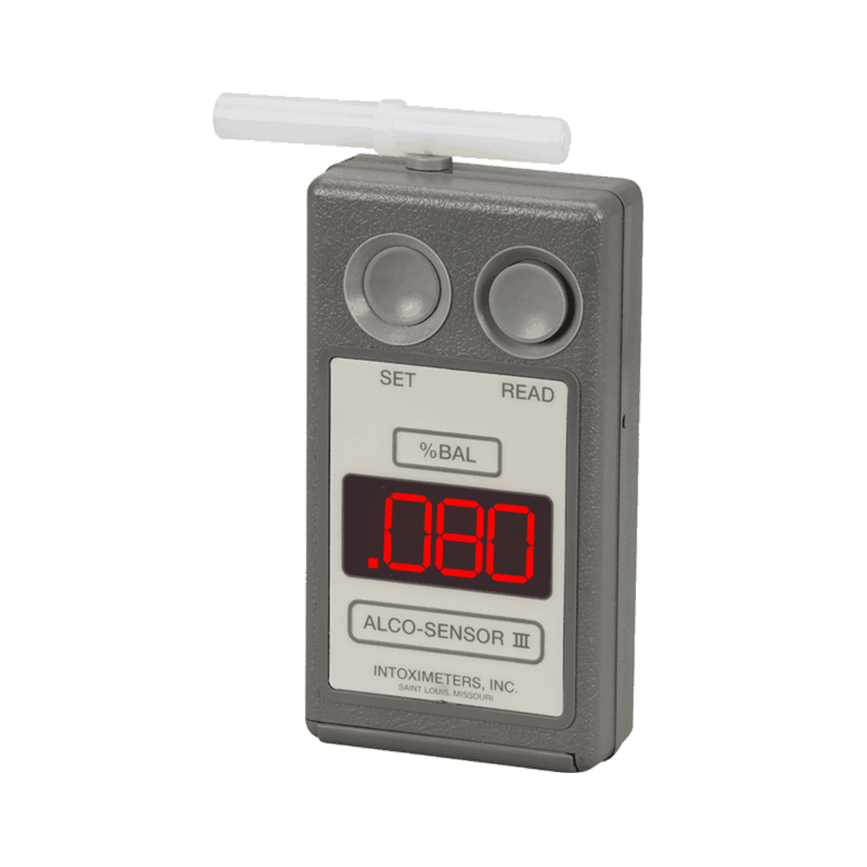

Slide 14
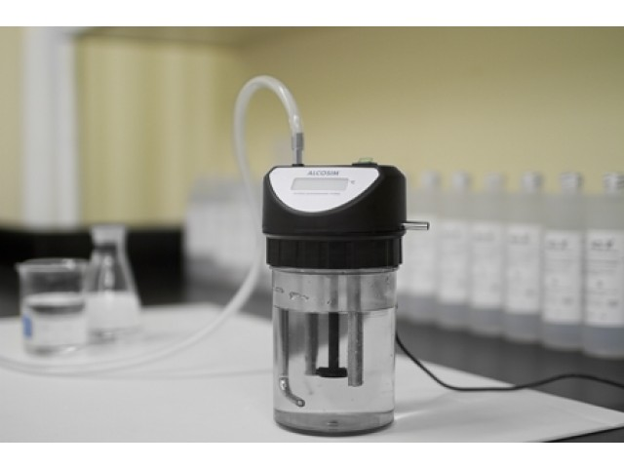
Breath Alcohol Test Simulator

Slide 15
Combined Systematic and Random Error
Systematic Error or Bias β
σ
ˆ
σ
Y
ˆ
Y
R
Random
Error ε

Slide 16
Uncertainty Functions for Breath and Blood Alcohol

Slide 17
Recommendation For Computing Measurement Uncertainty
Need only the Uncertainty Function and the allowed bias

Slide 18
Measurement Model for Breath Alcohol

Slide 20
Measurement Model for Breath Alcohol

Slide 21
Measurement Model for Breath Alcohol

Slide 22
Determining Combined Uncertainty
Sampling
Solution
Reference
Instrument
Part. Coef.
GC Controls

Slide 23
Combined Uncertainty
Uncertainty for the mean
0.0754 0.0850 g/210L

Slide 24
Uncertainty Budget
Source Distribution Type u Contrib
Sampling Normal A 0.0032 g/210L 88% GC Sol Normal A 0.00098 g/100ml 0.3% Reference Normal B 0.0004 g/100ml 0.9% Instrument Normal A 0.0011 g/210L 2% Part. Coef. Normal A 0.00966 8% GC Cont Normal A 0.0007 g/100ml 0.8%

Slide 25
Percent Contribution to Combined Uncertainty

Slide 26
Reporting Results
The mean corrected measurement result was
0.0802 g/210L (n=2) with an expanded combined
uncertainty of 0.0048 g/210L assuming k=2 and a normal
distribution. An approximate 95% confidence interval for
the true mean breath alcohol result is
0.0754 to 0.0850 g/210L

Slide 27
Uncertainty Including the Sampling Component Only
0.076 0.0844 g/210L

Slide 28
The Confidence Interval for Breath Alcohol
Question: What level of uncertainty are we willing to accept?

Slide 29
An individual has a blood alcohol of 0.082 and 0.084 g/100ml. Are they in violation of the 0.080 per se? Are they over 0.080 g/100ml?
0.077g/100ml
0.089g/100ml
The best illustration of Measurement Uncertainty

Slide 30
The Probability That The True Mean Exceeds 0.080

Slide 31
Obtain R Statistical Software
Google: R
Download R for windows
Two files: Script and Data on C:\Indiana\R files
File: New Script (copy Script file)
Highlight Script file and run

Slide 32
Estimate Total Method Variation with Proficiency Data
Response Summary Item 1 Item 2 Item 3 Item 4 Item 5 Item 6 Item 7 Item 8
Preparation 0.03 0.04 0.08 0.10 0.15 0.21 0.25 0.28
Grand Mean 0.0370 0.0371 0.0775 0.1061 0.1478 0.2142 0.2482 0.2865
Standard Deviation 0.0031 0.0019 0.0024 0.0043 0.0037 0.0072 0.0060 0.0106
Phoenix PD Unc. Func. 0.00006 0.0001 0.0003 0.0004 0.0007 0.0009 0.0011 0.0013
2018 and 2019 Collaborative Testing Services Blood Alcohol

Slide 34
Computation of Measurement Uncertainty
GUM Bottom-Up-Approach – Breath Alcohol
Assumptions: multiplicative and independent Any Double-Counting?

Slide 35
The Confidence Interval for Breath Alcohol
Question: What level of uncertainty are we willing to accept?

Slide 36
Computation of Measurement Uncertainty
GUM Bottom-Up-Approach – Blood Alcohol
Assumptions: multiplicative and independent Any Double-Counting?

Slide 37
The Confidence Interval for Blood Alcohol
Question: What level of uncertainty are we willing to accept?

Slide 38
Excel Summary of Measurement Uncertainty

Slide 39
Develop from the
Uncertainty function

Slide 40
How should the statement of measurement uncertainty be presented?
How should this be determined?

Slide 41
A Possible Statement of Uncertainty
The mean corrected measurement result was
0.0802 g/210L (n=2) with an expanded combined
uncertainty of 0.0048 g/210L assuming k=2 and a normal
distribution. An approximate 95% confidence interval for
the true mean breath alcohol result is
0.0754 to 0.0850 g/210L
Have manufacturer write code to do computation and have
this printed on the document

Slide 42
Forensic Question:
Which Is The Better Protocol?
Duplicate Control with Single
Breath Alcohol Analysis
Single Control with Duplicate
Breath Analysis

Slide 43
Uncertainty in the Context of Replicate Measurements
The following confidence interval illustrates the effect of replication on breath
alcohol measurement uncertainty
Replicate the component with the largest variability

Slide 44
Duplicate Breath Alcohol Agreement Based on Analytical
And Biological Variation
RCV = Reference Change Value, the maximum allowed
change in serial measurements

Slide 45
Sources of Imprecision in
Breath Alcohol Analysis
Analytical Sampling
Total

Slide 46
Sources of Measurement Variability

Slide 47
Effect Size
Assume you want to evaluate whether food in the stomach effects the alcohol elimination rate. You have 25 volunteers who eat a full meal and 25 who have an empty stomach. All are given an alcohol dose of 1.2 g/Kg
Below are the results:
Full stomach Empty stomach
Mean β = 0.016 g/210L/hr Mean β = 0.019 g/210L/hr
SD = 0.002 g/210L/hr SD = 0.006 g/210L/hr
n=25 n=25
Cohen’s d (effect size) 0.66 is a very strong effect

Slide 48
You obtain a blood alcohol result for the defendant of 0.128 and 0.129 g/100ml. Six months later the defense wants it tested again. Now you get 0.116 and 0.114 g/100ml. Are the results significantly different? How do you answer and explain the change?

Slide 49
We assume that the measurement of blood alcohol within an individual is normally distributed and has the standard deviation determined from: S = 0.0049BAC+0.00009. We compute a 95% confidence interval for the difference between these two means

Slide 50
Should you report an uncertainty along with your estimate in a retrograde extrapolation? How would you compute this uncertainty value?

Slide 51
0.1425
0.1155
0.0865

Slide 52
You compute Widmark’s estimate of the number of drinks the individual had and obtain an estimate of 10.4 beers. Do you present this number or also include an uncertainty for it? How would you compute the uncertainty? What terms in Widmark’s equation are uncertain?

Slide 53
BAC
Widmark’s model is valid only in
the post-absorptive phase
BAC = 0.15(1-e^{-6t})-0.015t
Time (hrs)

Slide 54
Uncertainty in Widmark’s Calculation : Taylor Series
Value St. Dev.
W 180lbs 3.6lbs
r 0.73L/Kg 0.067L/Kg
C_{t} 0.0012Kg/L 0.000043Kg/L N = 10.4 drinks
β 0.000148Kg/L/hr 0.000032Kg/L/hr u_{N} = 1.27 drinks
t 5hr 0.1hr CV = 12.2%
D 0.82oz/floz 0.0082oz/floz
A 0.48floz/drink 0.014floz/drink 10.4+/-1.96(1.27)
7.9 to 12.9
Assumptions: mixed model and independent

Slide 55
How many digits should your measurements be reported to? What influence does this have on uncertainty?
BrAC Results: 0.124, 0.131 SD = 0.0038
Mean = 0.1275 same precision

Slide 56
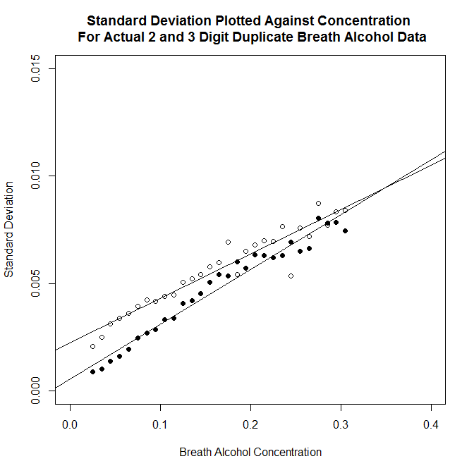

Slide 57
Uncertainty Functions For North Carolina Blood Alcohol
At 0.080 g/100ml
S = 0.00197 g/100ml S = 0.00262 g/100ml
95% CI: 0.076 – 0.084 g/100ml 95% CI: 0.075 – 0.085g/100ml

Slide 58
Several Ways to Estimate Uncertainty
1. Empirical, uncertainty budget approach (example given)
2. Modeling approach
3. Proficiency test data
4. Collaborative between-lab test data
5. Deduct some percent (6% in UK)
6. Guard band
7. Employ the Total Allowable Error
8. Monte Carlo Simulation
9. Bayesian approach
10. Legal approach (case law)

Slide 59
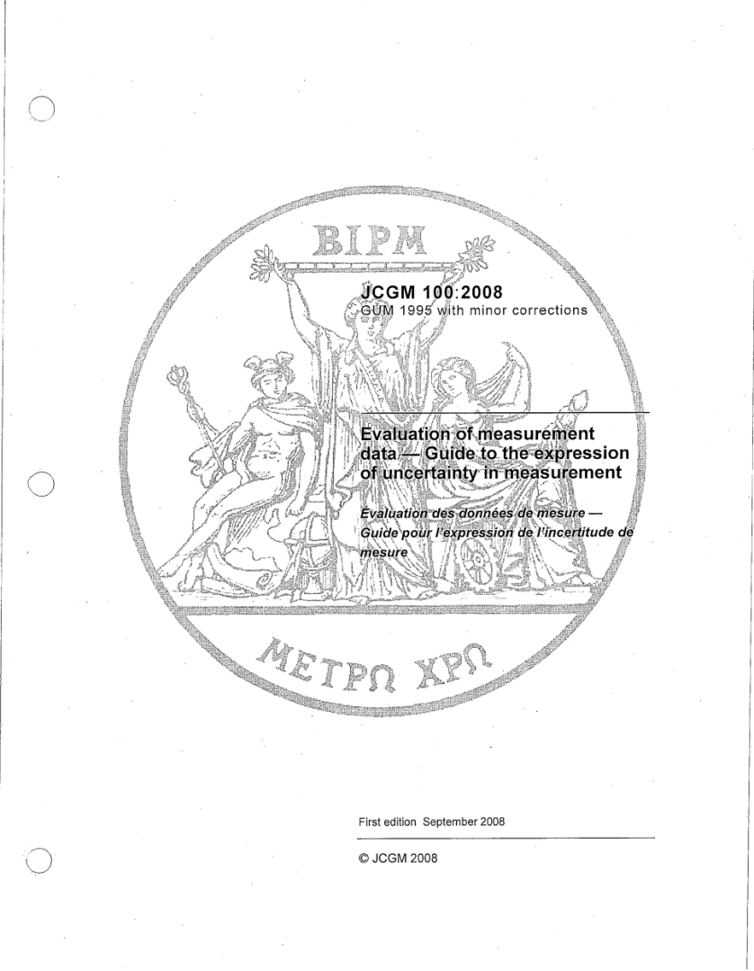
Guide to the Expression of Uncertainty GUM Document
http://www.bipm.org/en/publications/guides/gum.html

Slide 60
EURACHEM/CITAC Uncertainty Document
http://www.eurachem.org/imges/stories/Guides/pdf//QUAM2012_P1.pdf

Slide 61
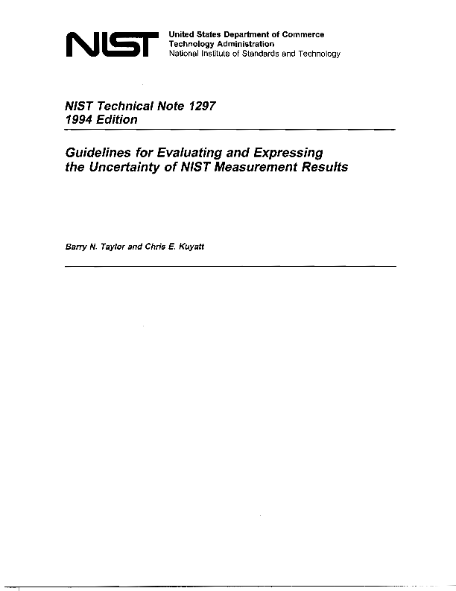
NIST Uncertainty Document
http://physics.nist.gov/Pubs/guidelines/contents.html

Slide 65
Statistics and Probability for Advocates:
Understanding the Use of Statistical
Evidence in Courts and Tribunals
Royal Statistical Society

